Slide 1
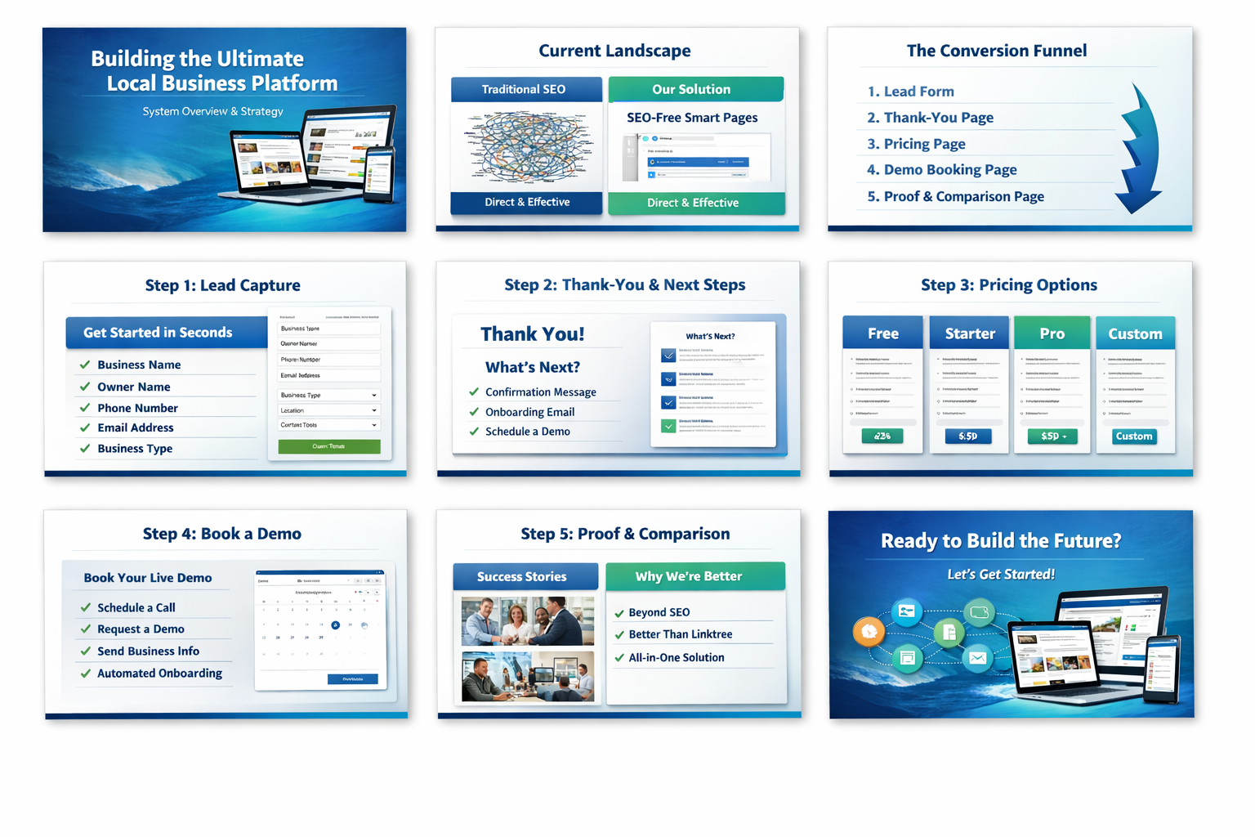
AWAVEGENT PLATFORM
Local business pages,
bookings, SMS, and verified reviews
A modular platform for restaurants, charters, activities, and service businesses — connected to Gulf Coast Radar.
One update everywhere
Source tracking
Verified reviews
What this deck covers
• What the platform is
• Niche pages and funnel
• What makes it different
• What to build next
aWavegent • smart pages, bookings, SMS, verified reviews
1

Slide 2
What aWavegent actually is
3-layer platform model
Three connected layers, not one isolated tool
GCR brings discovery, aWavegent runs the business page + customer flow, and Ghost OS powers the intelligence and SMS layer.
Visual system map
Use the public-facing pages to sell the business system, then route leads into your intake, demo, and onboarding flow.
1. Gulf Coast Radar (GCR)
Consumer-facing discovery layer for listings, “things to do,” category pages, and local demand.
Discovery
Business Ops
AI / SMS
2. aWavegent
Business-facing layer: smart pages, booking flow, QR menus, CRM, source tracking, and owner dashboard.
3. Ghost OS
AI / SMS / voice automation for owners and customers.
aWavegent • smart pages, bookings, SMS, verified reviews
2

Slide 3
The niche sales pages
Each vertical gets its own story
You now have a modular front-end pitch for four business types.
Restaurants
Charters
Activities / Rentals
Services
QR menus, daily specials, reservation reminders, verified dining reviews.
Trip booking flow, captain briefings, source tracking, post-trip reviews.
Open inventory, same-day demand fill, booking flow, review follow-up.
Lead capture, appointment reminders, owner alerts, verified job reviews.
What these pages do well
What they still need
• Make the business feel seen by niche
• Lead with outcomes, not a giant feature dump
• Create an easy bridge into the lead form and demo funnel
• More premium visuals
• Live demo links per vertical
• Real form submission / CRM wiring
• Stronger proof and testimonials over time
aWavegent • smart pages, bookings, SMS, verified reviews
3

Slide 4
The conversion funnel
What happens after a prospect clicks
You also created the pages that turn traffic into actual conversations.
1
1. Lead form
Collect business, owner, niche, website, and current tool stack.
Why this matters
Without these pages, the niche pages are just brochures.
With them, you have an actual site funnel:
• traffic → intake
• intake → demo
• demo → onboarding
• onboarding → owner dashboard
2
2. Thank-you page
Tell them what happens next and push them into one more action.
3
3. Pricing page
Give structure to the free / growth / custom offer.
4
4. Demo booking page
Make it easy for serious prospects to book a conversation.
5
5. Proof / comparison page
Explain why this beats a basic page builder or disconnected tools.
aWavegent • smart pages, bookings, SMS, verified reviews
4

Slide 5
What makes the system different
The strongest parts to lead with
The best parts are not generic “AI agents.” They are operationally useful.
Booking / lead engine
Verified reviews
Source tracking
SMS ops
The cleanest entry point because it ties directly to revenue and ROI.
Trust layer tied to real bookings, visits, jobs, or reservations.
Know whether business comes from GCR, social, Google, direct, SMS, or referrals.
Daily prompts, reminders, confirmations, and owner alerts.
The core promise
The moat
One update can keep the smart page, QR menu, booking flow, and Gulf Coast Radar listing aligned.
That is the practical painkiller businesses will understand fastest.
Not just AI.
• Local-first structured business data
• Discovery + operations + trust in one loop
• Verified post-booking actions
• Channel attribution + repeat-customer potential
aWavegent • smart pages, bookings, SMS, verified reviews
5

Slide 6
What to build next
From pitch deck to working product funnel
You have enough to pitch. The next layer is turning this into a real selling machine.
Connect forms to CRM / email
Best launch order
Make intake and demo requests actually go somewhere.
1. Lead form + thank-you
2. Pricing + proof pages
3. Live demo booking
4. Admin invite / owner access
5. Real examples and testimonials
Add live demo examples
One real example per niche will raise trust fast.
Tighten copy + make visuals more premium
The structure is there; polish will increase conversion.
Keep the front-end pitch simple:
“We build you a better page, connect the customer flow, and keep it all updated from one place.”
Build owner invite flow + dashboard assignment
This is the handoff from sales site into product.
Add analytics and case studies as soon as possible
Proof beats promises.
aWavegent • smart pages, bookings, SMS, verified reviews
6

Slide 7
What you have now
A full niche sales set + a working funnel foundation
• Homepage
• 4 niche sales pages
• Lead form
• Thank-you page
• Pricing page
• Demo booking page
• Proof / comparison page
Next: connect it to the real backend
The pitch layer exists. Now the goal is wiring it into owner onboarding, data sync, and real customer flow.
aWavegent • smart pages, bookings, SMS, verified reviews
7

